Slide 1


Slide 2
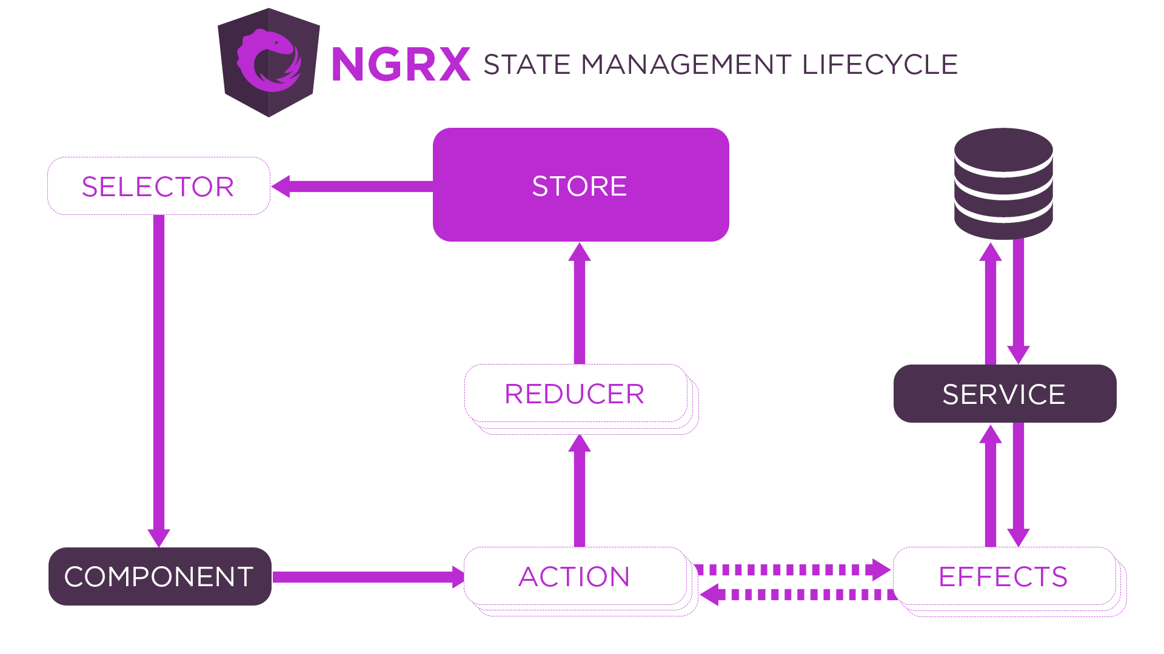
Angular NGRX
Angular
55

Slide 3
Angular NGRX
Angular
55
Redux is a reactive state management library developed by Facebook and used in the React library. This library is based on the Flux pattern. The main difference between Flux and Redux is how they handle actions; in the case of Flux, we usually have multiple stores and a dispatcher, whereas Redux has a single store, which means a dispatcher is not needed.
To use Redux in the Angular framework, we can use the NgRx library. This is a reactive state management library. With NgRx, we can get all events (data) from the Angular app and put them all in the same place (Store). When we want to use the stored data, we need to get it (dispatch) from the store using the RxJS library. RxJS (Reactive Extensions for JavaScript) is a library based on the Observable pattern that is used in Angular to process asynchronous operations.

Slide 4
Angular NGRX
Angular
55
So far, so good, but why should we use Redux in an Angular application instead of a shared service for example? We can use a service to share data between components (make sure to unsubscribe the observable every time, otherwise you risk needlessly running the observable in the background, which consumes resources) or we can use the Input/Output data flow (make sure the components have a parent/child relationship).
We can also use ViewChild for nested components. But in the case of a large project, these solutions will increase the project complexity. If we have a large number of components, we risk losing control over the data flow within a component (where did this data come from and what is its intended destination?)
This is the reason why we use Redux in Angular: the store and the unidirectional data flow reduce the complexity of the application. The flow is more clear and easy to understand for new team members.

Slide 5
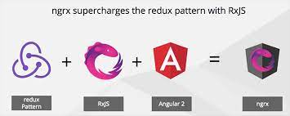
Angular NgRX
Angular
55

Slide 6
Angular NGZONE
Angular
55
all asynchronous operations are inside the Angular zone, which triggers change detection automatically. Another common case is when you don't want to trigger change detection. In that situation, you can use another NgZone method: runOutsideAngular()

Slide 7
That’s All For Today Day-9 !!
Questions?

Slide 8
Thank You
shiva1991@live.com

